Slide 1



Presented by
Adyaprana Pradhan
Praveen ku. Chandra
Harsh Mridul
Supervisor
Prof. Kamakhya Narain Singh
prof. Prachi Vijayeeta
prof. Satya Ranjan Dash
AI-Based Smart Virtual Assistant

Slide 2
Introduction
Objectives
Existing System
Proposed System
Technology Used
Implementation
Testing & Results
Advantages & Limitations
Future Scope
Conclusion
Outline

Slide 3
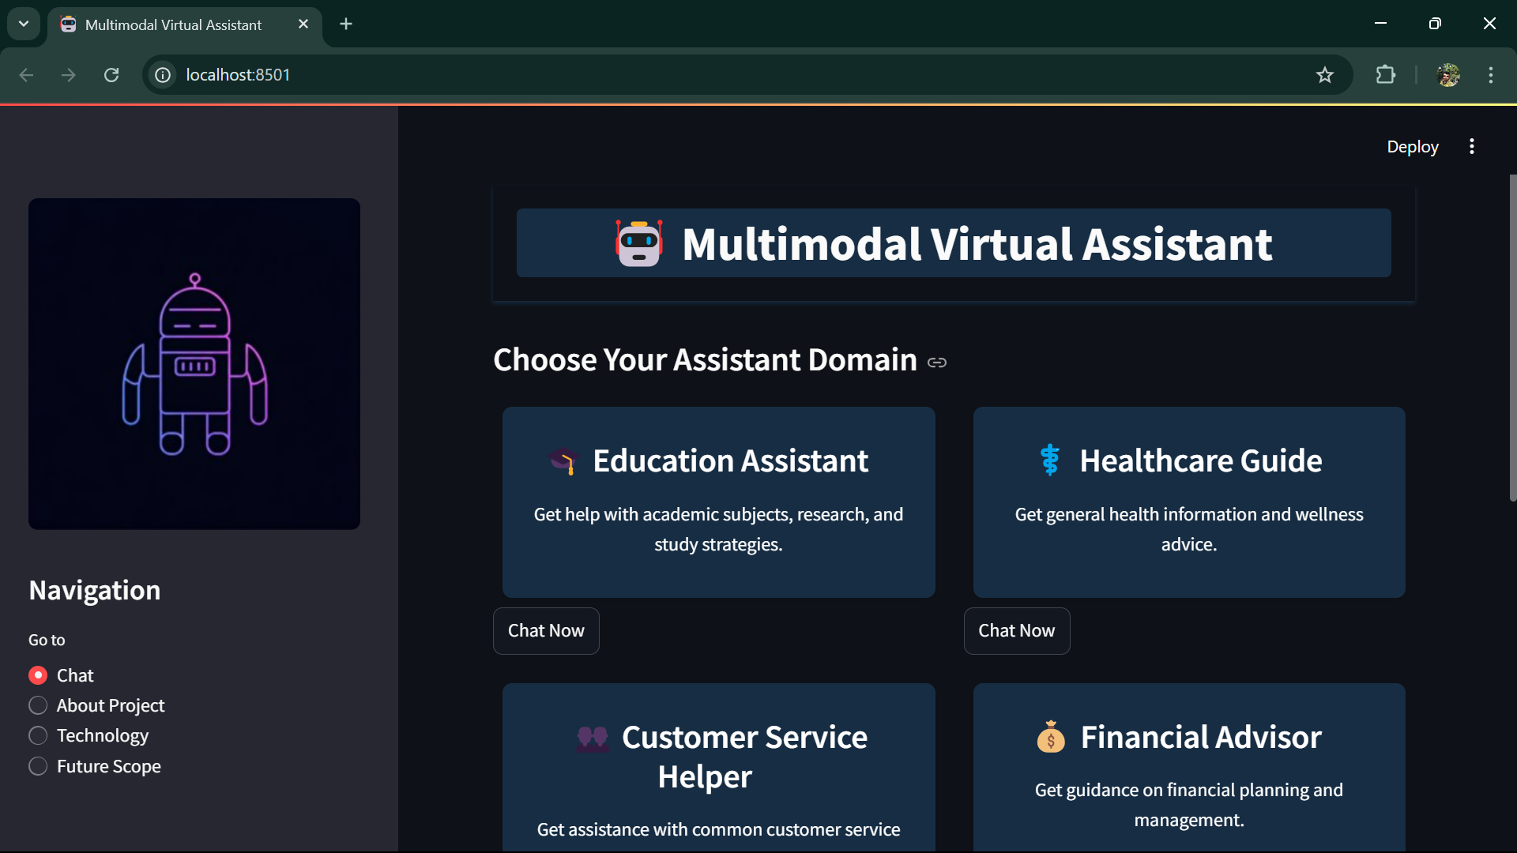
Introduction
Introduction
AI is transforming how we interact with technology—think Siri or Alexa, but smarter!
This project: An AI-Based Smart Virtual Assistant built with Python, Streamlit, and Mistral API.
Goal: A web-based tool for real-time help with queries, summaries, and tasks.
Why it matters: Simplifies life for students, professionals, and beyond!

Slide 4
Objective
Ensure fast, real-time interactions.
Build a web-based assistant for diverse tasks.
Design a simple Streamlit UI for all users.
Integrate Mistral AI for smart, human-like responses.
Create a scalable system for future upgrades.

Slide 5
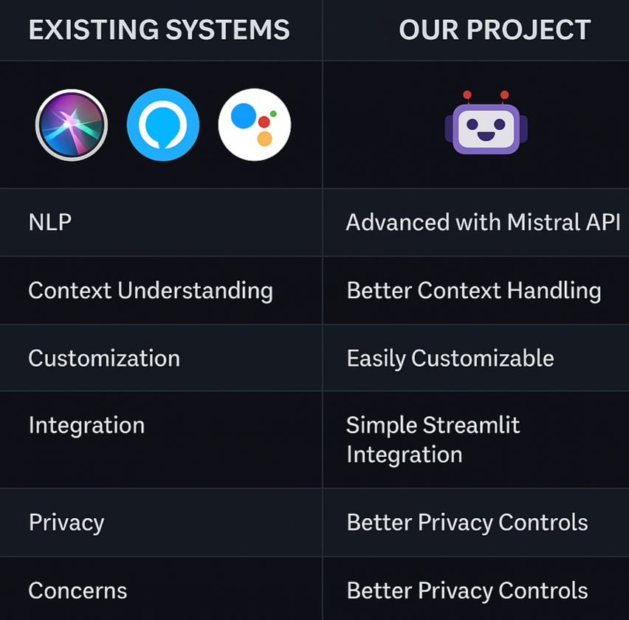
Existing system
Examples: Siri, Alexa, Google Assistant.
Features: Basic NLP, task-specific scripts.
Limitations:
Weak context understanding.
Limited customization.
Integration challenges.
Privacy concerns.
A
B

Slide 6
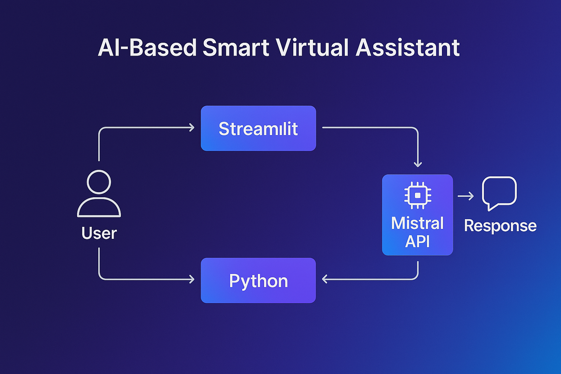
Proposed system
AI-Based Smart Virtual Assistant:
Smarter replies via Mistral API.
Solves: Context issues, rigid functionality, and more!
Multi-tasking: Answers, summaries, content generation.
Secure & scalable design.
Streamlit UI: Simple, web-based, accessible.

Slide 7





Technology Used
Python
Streamlit
Mistral AI
Python is used for its simplicity, vast libraries, and easy integration for building AI applications.
Streamlit is used to create fast and interactive web-based user interfaces for the project.
Mistral AI is used to generate accurate and smart responses, enhancing the chatbot's intelligence and user experience.
SpeechRecognition, Pyttsx3
Requests & JSON
Convert speech to text using a microphone input. and Text-to-speech conversion in Python. Future voice input/output feature.
To send HTTP requests (GET, POST) to APIs or external services. (Great for API integration.) and
To handle JSON data (parse, read, write).

Slide 8
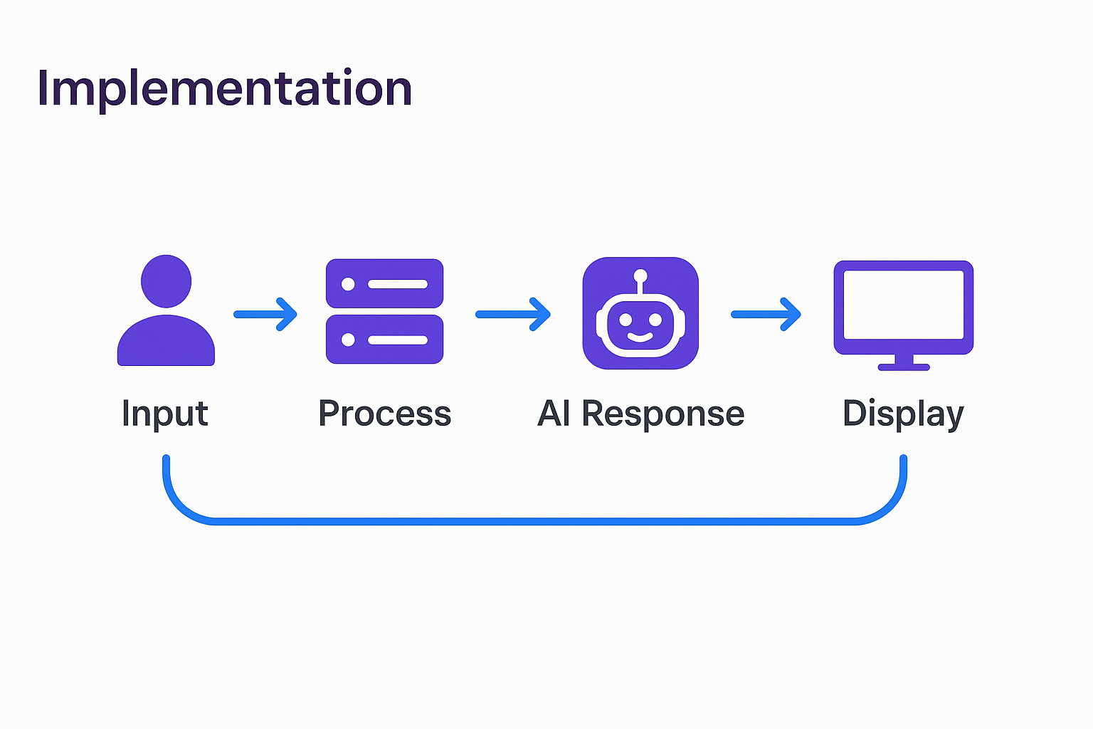
Implementation
Modules:
Login: Manages secure user authentication and access control.​
Chatbot: Handles real-time natural language processing (NLP) interactions with users.​
API Integration: Connects with the Mistral API to generate intelligent responses.​
Content Generation: Creates summaries and reports based on user inputs.

Slide 9
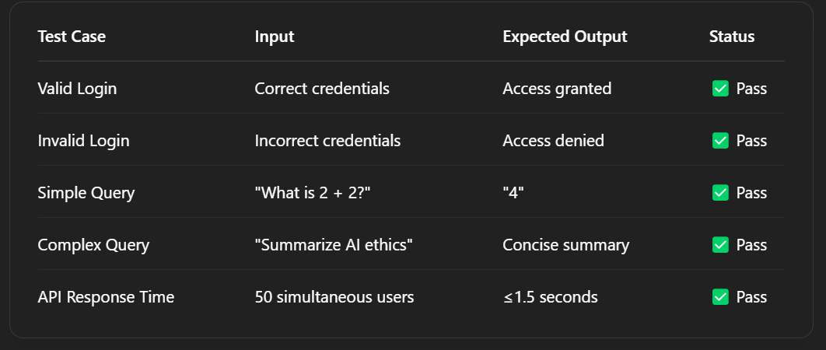
Testing & Results
Modules:
Testing:
Unit, Integration, Functional.
Test Cases:
"Valid login" -> Pass.
"Simple query (2+2)" -> "4".
Results:
95% test success rate.
1.5-sec response time for 50 users

Slide 10
Advantages & Limitations
Advantages of AI-Based Virtual Assistants
Limitations of AI-Based Virtual Assistants
24/7 Availability
AI assistants operate continuously without breaks, providing instant support at any time of the day or night.
Task Automation
They efficiently handle repetitive tasks such as scheduling, reminders, and information retrieval, freeing up human resources for more complex activities.
Scalability and Cost Efficiency
AI assistants can manage multiple interactions simultaneously without additional costs, making them a scalable solution for growing demands.
Enhanced Productivity
By automating routine tasks, they allow users to focus on higher-priority work, thereby increasing overall productivity.
Consistency in Responses
AI assistants provide uniform answers to queries, ensuring consistent information delivery across all interactions.
Challenges with Complex Queries
They may struggle to understand or accurately respond to nuanced or context-rich questions, leading to potential misunderstandings.
Dependence on Internet Connectivity
Most AI assistants require a stable internet connection to function effectively; without it, their capabilities are significantly reduced.
Lack of Emotional Intelligence
AI lacks the ability to comprehend and respond to human emotions, making it less effective in situations requiring empathy or emotional nuance.
Privacy and Security Concerns
Handling sensitive user data raises concerns about data privacy and the potential for unauthorized access or breaches.
Limited Personalization
While AI can be programmed for certain preferences, it may not fully adapt to individual user behaviors and preferences over time.

Slide 11
Future Scope
Option 1
Voice Input/Output: Implementing speech recognition and synthesis for hands-free, natural interactions.
Emotional Intelligence: Integrating sentiment analysis to understand user emotions and provide empathetic responses.
Option 4
Option 2
AR/VR Integration: Utilizing augmented and virtual reality technologies to offer immersive assistance experiences.
Option 3
Multilingual Support & Advanced Security: Expanding language capabilities to cater to a diverse user base and enhancing security measures to protect user data.

Slide 12
Conclusion
A Smart, Practical Assistant for Today's Needs
Challenges Faced:
Developed an AI-based virtual assistant that efficiently handles real-time queries and tasks, enhancing user productivity.
Addressed concerns related to data privacy and the handling of complex user queries, identifying areas for future improvement.
Key Learnings:
Next Steps:
Gained proficiency in Python programming, API integration, user interface design with Streamlit, and comprehensive testing methodologies.
Plan to incorporate advanced features such as voice interaction, emotional intelligence through sentiment analysis, and multilingual support to broaden the assistant's impact.

Slide 13
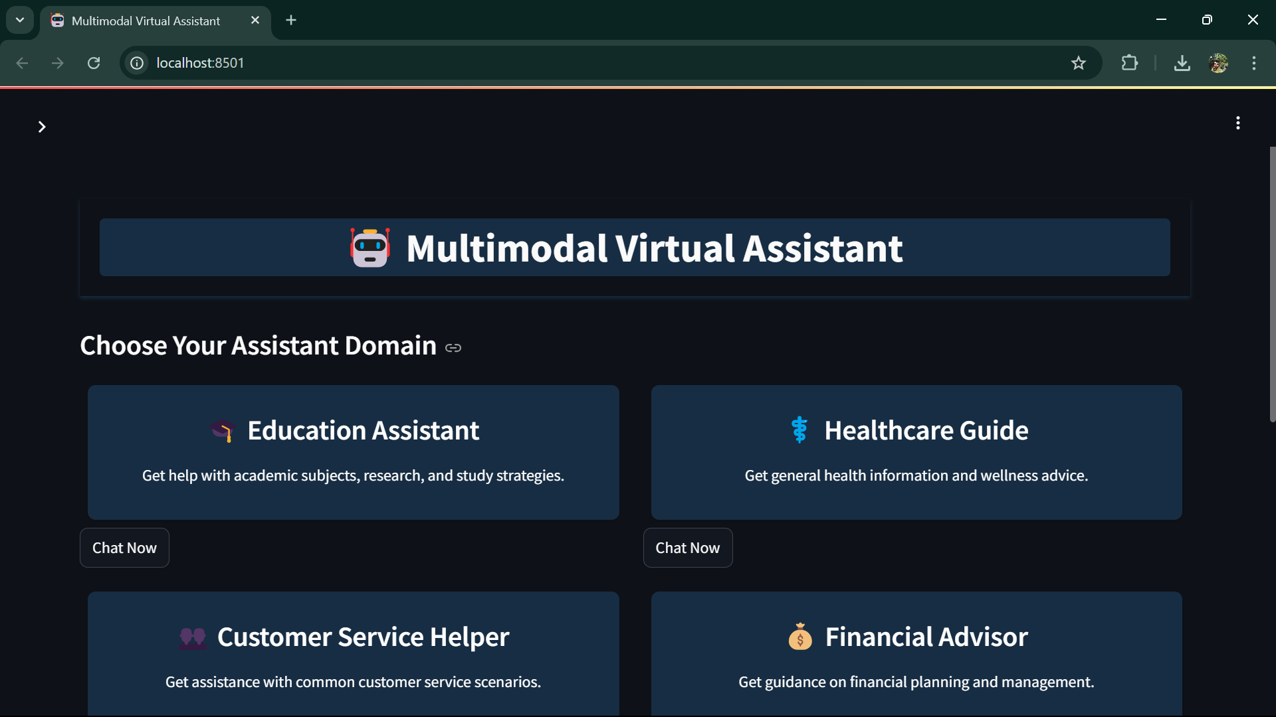
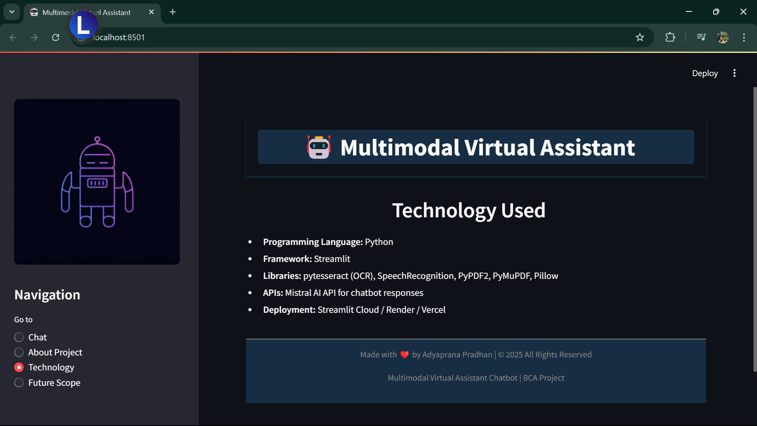
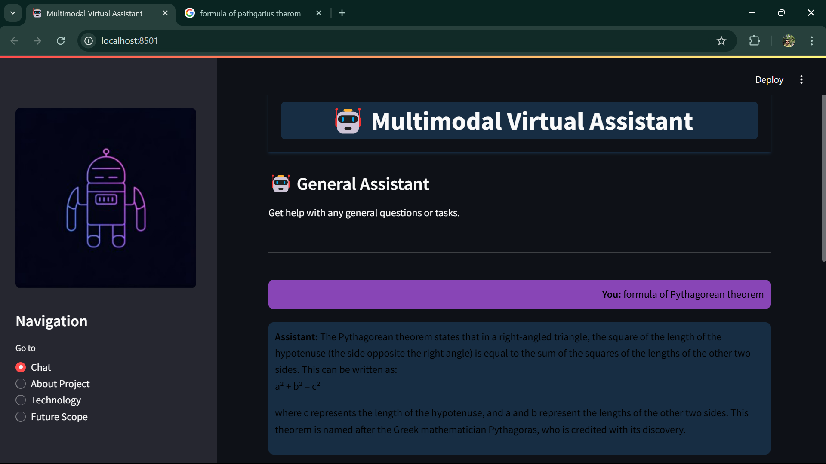
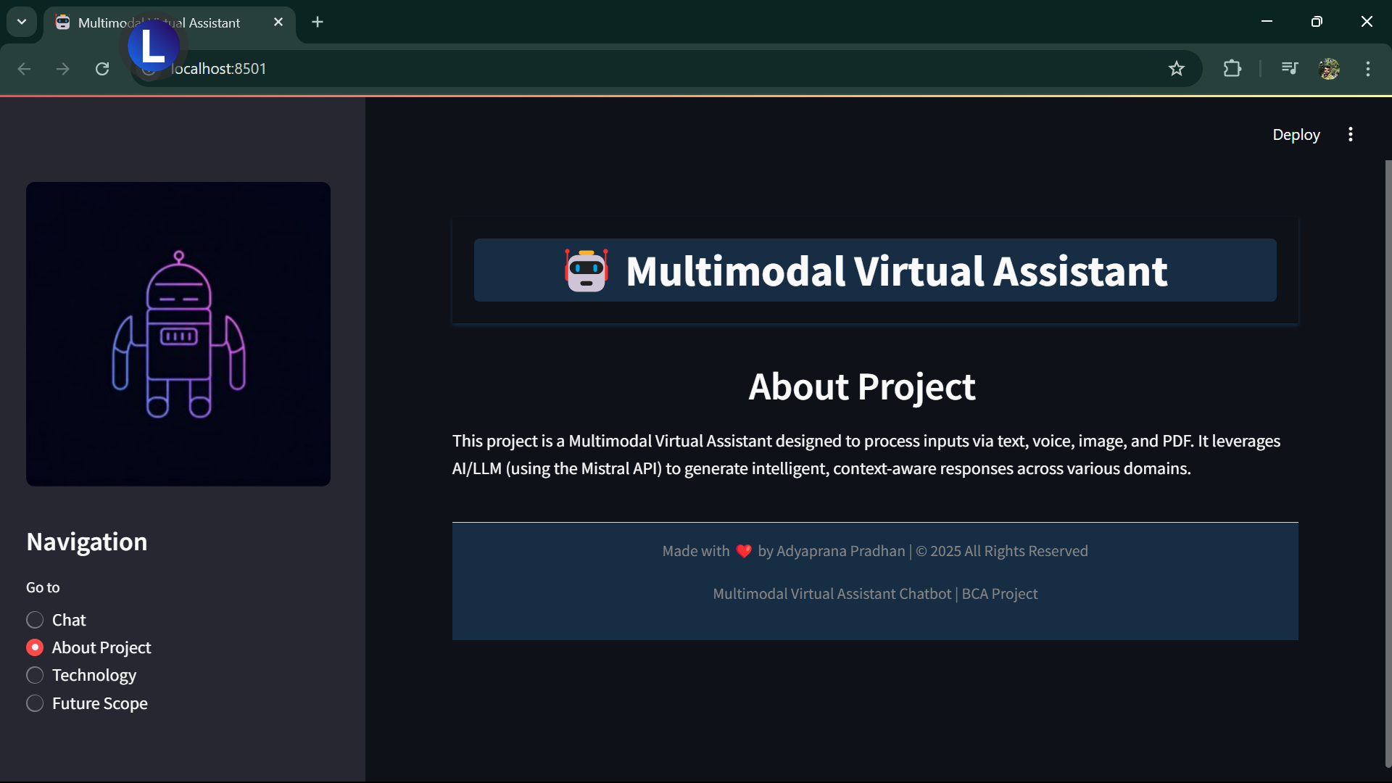
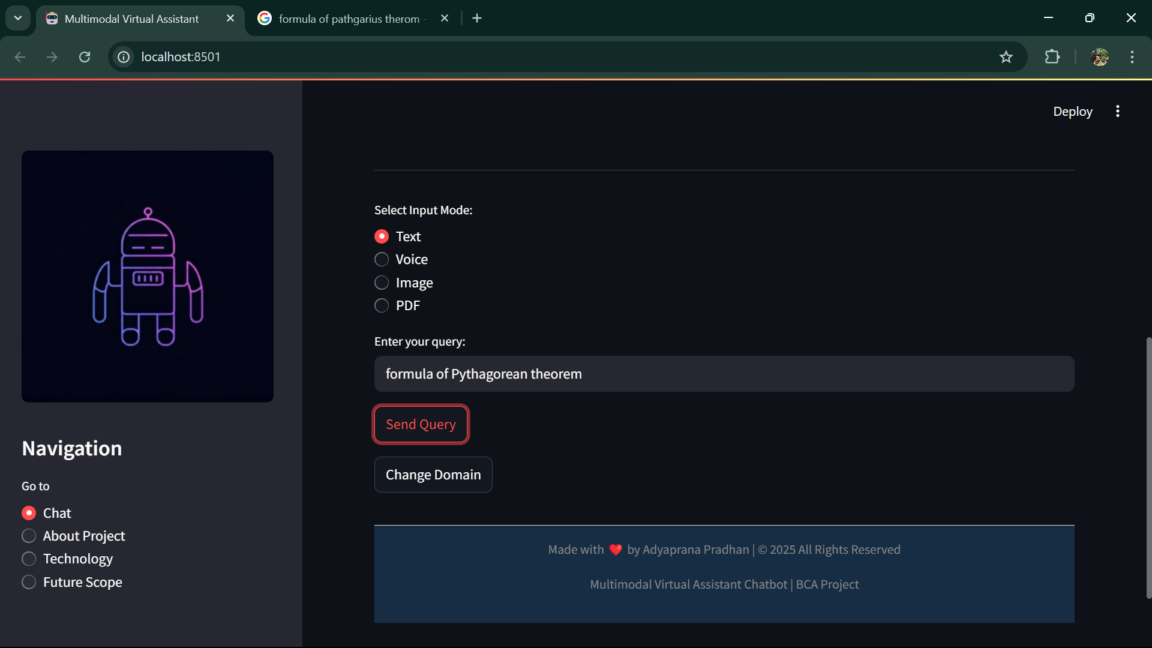
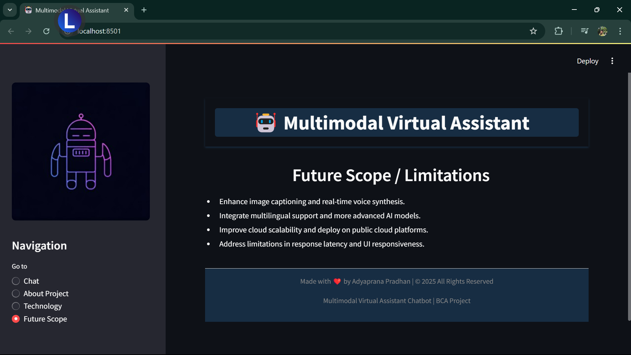
Project Screenshot
Title text addition
The user can demonstrate on a projector or computer, or print the presentation and make it film
Title text addition
Title text addition
The user can demonstrate on a projector or computer, or print the presentation and make it film
The user can demonstrate on a projector or computer, or print the presentati and make it film

Slide 14
THANK YOU

